Slide 1
Space Needs Assessment: Outcomes
Space Needs Survey
Assumptions
Existing Parking
Existing Uses
Key Issues
Potential Uses
Other Considerations

Slide 2
Space Needs Assessment: Space Needs Survey
Aging Disabilities Resource Center
Unified
Personnel
Social Services
Information Technology
Finance
Clerk
Health
Register of Deeds
Zoning & Sanitation
Veterans
Treasurer

Slide 3
Space Needs Assessment: Assumptions
Timing
Uses
Purpose

Slide 4
Space Needs Assessment: Assumptions
Timing
Uses
Purpose
There have been trends toward delivering
services regionally as opposed to a County
model.
Funding appears to be stable for the next
couple of years.
The political environment is unpredictable.
In 2012, the County makes its final payment
on the Administrative Building.

Slide 5
Space Needs Assessment: Assumptions
Timing
Uses
Purpose
Law Enforcement, Finance, and the Holiday
Project should be included.
May want to consider uses outside of the
County.

Slide 6
Space Needs Assessment: Assumptions
Timing
Uses
Purpose
There appears to be a political push to
populate the 3rd Floor of the Administrative
Building.
There could be long-range economic
benefits from using vacant County-owned
space as opposed to renting space.
Additional study would need to be
conducted to determine the potential
impacts.

Slide 7
Space Needs Assessment: Existing Parking
 | Downtown Parking Capacity
 |  | With Time-Restricted Stalls |  | Without Time-Restricted Stalls
 | Street | Average | Maximum | Average | Maximum
 | Total Available Parking Stalls (Street) | 692.0 | 692.0 | 515.0 | 515.0
 | Total Used Parking Stalls (Street) | 183.6 | 194.0 | 183.6 | 194.0
 | Total Open Parking Stalls (Street) | 508.4 | 498.0 | 331.4 | 321.0
 | Percentage of Stalls Used (Street) | 27.0% | 28.0% | 35.7% | 37.7%
 | Percentage of Stalls Open (Street) | 73.0% | 72.0% | 64.3% | 62.3%
 | Surface Lots
 | Total Available Parking Stalls (Lot) | 165.0 | 165.0 | 165.0 | 165.0
 | Total Used Parking Stalls (Lot) | 105.1 | 108.0 | 105.1 | 108.0
 | Total Open Parking Stalls (Lot) | 59.9 | 57.0 | 59.9 | 57.0
 | Percentage of Stalls Used (Lot) | 64.0% | 65.0% | 64.0% | 65.0%
 | Percentage of Stalls Open (Lot) | 36.0% | 35.0% | 36.0% | 35.0%
 | Total
 | Total Used Parking Stalls | 857.0 | 857.0 | 680.0 | 680.0
 | Total Used Parking Stalls | 288.7 | 302.0 | 288.7 | 302.0
 | Total Open Parking Stalls | 568.3 | 555.0 | 391.3 | 378.0
 | Percentage of Stalls Used | 33.7% | 35.2% | 42.5% | 44.4%
 | Percentage of Stalls Open | 66.3% | 64.8% | 57.5% | 55.6%

Slide 8
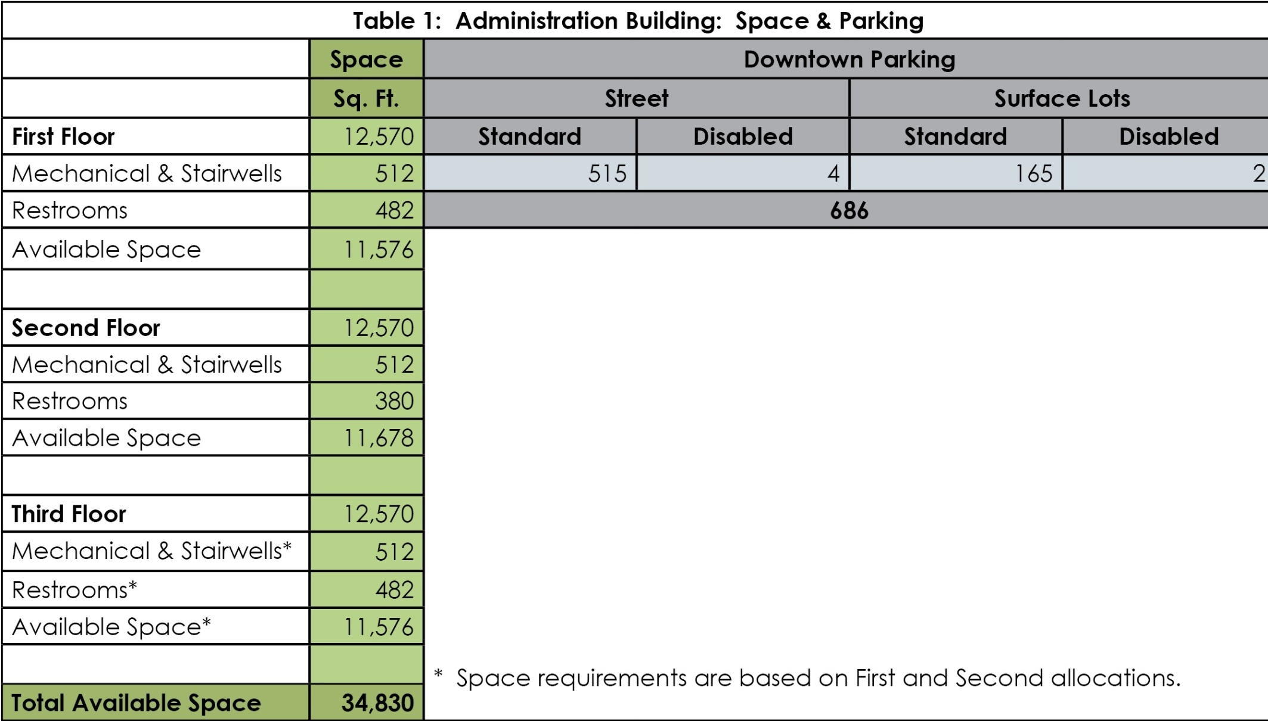
Space Needs Assessment: Existing Uses

Slide 9
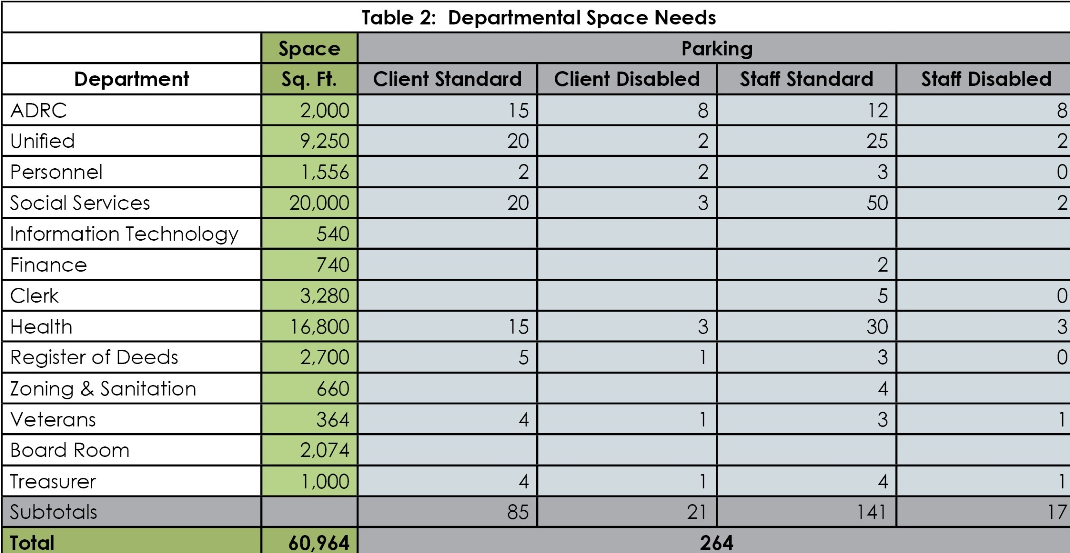
Space Needs Assessment: Existing Uses

Slide 10
Space Needs Assessment: Existing Uses

Slide 11
Space Needs Assessment: Existing Uses

Slide 12
Space Needs Assessment: Existing Uses

Slide 13
Space Needs Assessment: Existing Uses

Slide 14
Space Needs Assessment: Key Issues
Parking
Elevator
Service Delivery
Safety, Security
& Disruption

Slide 15
Space Needs Assessment: Key Issues
Parking
Elevator
Service Delivery
Safety, Security
& Disruption
Additional county uses would demand
additional disabled parking and
loading areas for clients. This is a safety
concern.
County employees who are not
disabled, should be able to walk to
work from an off-site parking location.
It is extremely difficult and dangerous
for families and disabled persons to
load and unload from on-street
parking, especially in the winter.

Slide 16
Space Needs Assessment: Key Issues
Parking
Elevator
Service Delivery
Safety, Security
& Disruption
If the 3rd Floor of the Administration
Building is to be used regularly, then the
elevator must be upgraded. The
current elevator is much too slow.

Slide 17
Space Needs Assessment: Key Issues
Parking
Elevator
Service Delivery
Safety, Security
& Disruption
With rising costs of fuel, the County
maybe forced to look at a ‘satellite’
system for delivering services. This may
have significant impacts on the future
space needs.

Slide 18
Space Needs Assessment: Key Issues
Parking
Elevator
Service Delivery
Safety, Security
& Disruption
There is a concern that bringing
additional services to the Administration
Building will require additional security
and safety precautions due to the
specific needs of clientele.
It is not uncommon for police to be
called upon to remove clientele from
site. While this is a normal for some
County departments, it will likely disrupt
activities in departments that are
unaccustomed to such events. The
potential loss of productivity should be
considered.

Slide 19
Space Needs Assessment: Potential Uses
County Use
Other

Slide 20
Space Needs Assessment: Potential Uses
County Use
Other
Move Unified into the 1st Floor of the
Administration Building.
Pros:
County will no longer be paying rent and
be utilizing existing County space.
Cons:
Security, safety & disruption.
Cost of remodeling 1st and 3rd Floors.
Cost of moving departments.
Purchase and demolition costs of
adjacent building to develop loading
area for clients.
Level of service would diminish due to
access limitations for clients.

Slide 21
Space Needs Assessment: Potential Uses
County Use
Other
1. Develop 3rd Floor as Rental Property
2. Develop 3rd Floor as Business Incubator.
3. Status Quo

Slide 22
Space Needs Assessment: Potential Uses
County Use
Other
1. Develop 3rd Floor as Rental Property
2. Develop 3rd Floor as Business Incubator.
3. Status Quo
Pros:
Would generate revenue.
Cons:
Security.
Cost of remodeling 3rd Floor.

Slide 23
Space Needs Assessment: Potential Uses
County Use
Other
1. Develop 3rd Floor as Rental Property
2. Develop 3rd Floor as Business Incubator.
3. Status Quo
Pros:
Would generate some revenue.
Would provide opportunities for business
start-ups and business expansions.
Cons:
Security.
Cost of remodeling 3rd Floor.

Slide 24
Space Needs Assessment: Potential Uses
County Use
Other
1. Develop 3rd Floor as Rental Property
2. Develop 3rd Floor as Business Incubator.
3. Status Quo
Pros:
No additional costs.
Cons:
3rd Floor of Administration Building remains
vacant.

Slide 25
Space Needs Assessment: Other Considerations
The County is currently using some of the space on the 3rd
Floor as a workshop.
Any move will cost money and time in the short-run.
County Coroner could occupy former Corporation Counsel
space in the Courthouse.
Long-range plan to develop a ‘Health & Human Services’
facility with access appropriate for clientele.

