Slide 1

Raising A
Money Smart Child
Lori Baltrusis
Family Living Agent
Sawyer County UW Extension
Lori.Baltrusis@ces.uwex.edu
Gail Peavey
Family Living Agent
Polk County UW Extension
Gail.peavey@ces.uwex.edu
Notes:
When was the last time you talked with your kids about money? Was it a pleasant conversation? Please complete this little survey with me
What do you talk about the most? The least?
How are you doing with finding time to talk?
ACTIVITY: Talking with kids about money handout

Slide 2

What Research Tells Us
  Students knew more about income & spending than about money management & saving
The 2008 JumpStart financial literacy survey of high school seniors found
    Students answered 48.3% of questions correctly
    73% failed
http://www.jumpstart.org/survey.html
Notes:
Extension looks at research and help us understand how it can relate to our lives. Recent surveys tell us that seniors in high school are going out into the world less than prepared to be financially successful.
Sept2013
44% WI school district requires course in Fin Lit to graduate; Gov Walker supports need to be financially literate—never more important;
White House Bulletin 2012—”Every American Financially Empowered” (www.whitehouse.gov) with goal to increase financial capacity and restore economic security

Slide 3
By the Numbers
By The Numbers

Slide 4
Chat Question:
Where do youth get most of their financial information?
  Teachers
  Media (Celebrities, Magazines, TV etc.)
  Friends
  Parents
Notes:
Unscientific poll from mint.org—parents main source of information
Parents: 67%
Media: 16%
TV, magazines, books
Friends: 13%
Teachers: 4%
Discussion Question: Reason this session is important—how do we better educate parents about the value of financial literacy

Slide 5

What Research Tells Us
  Parents are the main source of financial education (67%)*
  94% of students ages 16-22 say they are likely to turn to their parents as a source of financial information**
  Only 26% of 13- to 21-year-olds report that parents actively taught them how to manage money. **
*2010 themint.org poll (Unscientific Poll) **2001 Youth and Money Survey
Notes:
Parents can model good and bad behaviors about money. What would your kids say?
Teach and model good money mgmt skills more likely to become adults who make sound financial decisions
According to findings in 2013 Annual Parents, Kids and Money Survey from T. Rowe Price
Only 38% talk about credit, budgets and other family financial issues with their children
36% of kids say they are being left in the dark
47% of parents say they do not always agree with one another about money matters
44% of kids say they know Mom and Dad have money disagreements
Half or fewer of parents:
Save regularly for retirement
Buy life insurance
Save for vacation
Regularly contribute to charity
Save regularly for college
Have an up-to-date will
Northwestern Mutual survey says 43% of parents said that they did NOT feel capable talking about money with their children

Slide 6
What Research Tells Us
  Our kids can tell us about the “latest” and the “hottest” in the marketplace.
  They are steeped in advertising…
  Yet, they know very little about handling money.
  Huge number of our youth don’t know they should pay more than the required minimum on their credit card balance.
http://www.themint.org/parents/about-kids-today.html
Notes:
If kids carry such habits into adulthood, they are going to be making mistakes that have serious-long term consequences. It falls to parents to educate their kids.
Jonathan Clements, former financial columnist at Wall street Journal and current director of financial education at Citi Personal Wealth Mgmt. suggest making kids feel like the money they spend is theirs—one way to accomplish this is to give an allowance and guide them to determine how the money should be spent. RULE: never give in when they ask for more. With young children play a soda game—when you eat out offer $1 if they drink water instead of a soft drink.
HANDOUT: Money Sense for your Children—Where Money Comes from

Slide 7

Parents can:
Create daily conversations about money
Review the financial habits and attitudes we model for our kids
Notes:
As parents, we must move in two directions.
Every day, we need to create conversations about money – not lectures, but casual commentaries on situations that arise naturally in our days. The aim? To teach children a) how to think about money and b) make responsible decisions in using it. Give children a realistic sense of what was coming and ‘no bruised feelings’ later—how much parents/grandparents pay toward college or weddings, etc.
We must review our own financial habits so that we are modeling responsible financial behavior. Children quietly observe adults, and parents are "modeling" financial behavior all the time – whether or not we mean to.
from themint.org
HANDOUT: Daily Opportunity Challenge (the Mint.org/NW Mutual Foundation)
HANDOUT: How are you Doing?
HANDOUT: Money Talks

Slide 8
What Research Tells Us
  Grandparents growing resource for grandchildren
  More than half of grandparents (55%) say passing down the value of financial security is important to them.
*2012 Grandparents Investing in Grandchildren, Met Life, Generations United
Notes:
In addition, parents may have concern for adult children who have attempted to duplicate a parental lifestyle without the awareness of working within financial limits. The goals of beginning an investment portfolio, saving for a home, going to school, may get pushed aside in favor of ever-growing balances, the result of easy credit.
According to Kennon, author of Investing for Beginners, debt is the financial equivalent of handcuffs. Consumer debt and trivial purchases become very compelling reasons to teach young people how spending is supposed to work

Slide 9
What are the top three subjects most often avoided in “polite society?
Sex
Religion
Money
        Stanley & Einhorn, 2007
Notes:
So why is it so hard for us to talk about money

Slide 10
Money Habitudes
Habitudes (habits and attitudes) have more effect on money behaviors than knowledge
  Acquired through modeling by those around us in childhood
  Through experiences in youth and young adulthood
Syble Solomon, www.moneyhabitudes.com
Notes:
What is a habitude?
Attitudes are your first thoughts or feelings when you hear or see something
Habits are the automatic actions you take
Habitudes are the underlying influences that affects your behavior—in other words your values
We have all heard stories about people who win or inherit large sums of money are penniless in a few years. Having money does not mean we know how to shepherd it.
*Lead by example—pay your bills on time and stay out of debt. If children know you are up to your eyeballs in credit-card debt, they aren’t going to pay much attention to any wise words you might have about managing money.” Do as you do vs not as you say
Important to tell family stories that illustrate money values—i.e. about your humble roots or how you struggled when starting your career. That way children will understand they must work to earn their lifestyle. “We all had cockroaches in our apartment at one point.”

Slide 11

Money helps me…
Achieve my goals
  Targeted Goal
Feel safe and secure
  Security
Feel good by giving to others
  Selfless
Let life happen
  Free Spirit
Create a positive image
  Status
Enjoy the moment
  Spontaneous
Notes:
Determine your dominant style. Has your child developed a style yet? Each style has advantages and disadvantages. These styles also manifest in other parts of their lives – career and relationships. Those with Targeted Goal and Security tend to develop the most wealth. These folks have developed many of the skills we will talk about today. Moderating Spontaneous, Free Spirit, and Status with some of these habits and attitudes of Security and Targeted Goal may vaccinate our kids from credit and debt problems.
Values are the basic reason behind everything we do—Values represent what is the “Good Life” to each of us. We show our values in the way we talk and act—how we spend our time and in our spending choices. Knowing what is important to us helps us understand ourselves better.
HANDOUT: 6 Money Habitudes
ACTIVITY: Color of Money

Slide 12
Giving and Volunteering
Encourage children to buy food for food pantry
Encourage families to pack up clothes they’ve outgrown or toys and give to those less fortunate
Charity involves Gifts of TIME as well as money—encourage children offering of services without pay

Slide 13
How do we communicate about finances to the different generations?
Depression: 1901-1924
Silents: 1925-1940
Baby Boomers: 1941-1964
Gen X: 1965-1980
Millennials: 1981-1994
Generation Z: 1995-2009
Generation A: 2010-present
Notes:
*Generation—about 20 year span
what happens during formative years affect attitudes, values and perceptions
*Important to view through generational lens with money management views
*According to Joseph Hoffman, Institute of Certified Financial Planners (1999), “the issues often are complicated by the fact that people don’t like to talk about their money and that different generations often view money and its use in different ways.
HANDOUT: Stages of Development
HANDOUT: Teaching Financial Literacy Across the Generations
HANDOUT: The Road to Financial Responsibility
NOTE: Today’s kids have grown up in an era of relative economic prosperity and as a result:
Have money and spend it—who teaches them how to limit their spending
Watch parents use ATM—magical sources of money—who brings home the hard lesson that earning make those withdrawals possible
Use their parents’ credit cards or have their own—who teaches tweens and teen that, plastic transactions create debt? That debt eventually comes due
Are impressionable, easy targets of the marketplace. Who helps kids judge when they have enough? Needs vs wants
Are tech-savvy enough to bank online-who explains the basic of earning, saving, investing, debt, and spending; Who teaches older teens how finance charges or interest rates can add up?
OPTION: Discuss how the different generation handle money conversations with children/youth:
Your parents
You and your spouse/partner
Your adult children/grandchildren

Slide 14

When’s A Good Time to Talk?
Mealtime
In the car
During quiet activities
Watching TV
Shopping together
Paying bills
Notes:
So many factors to consider when discussing money:
Your values/habitudes
Generational differences
Determining when, how, where to talk about money issues

Slide 15
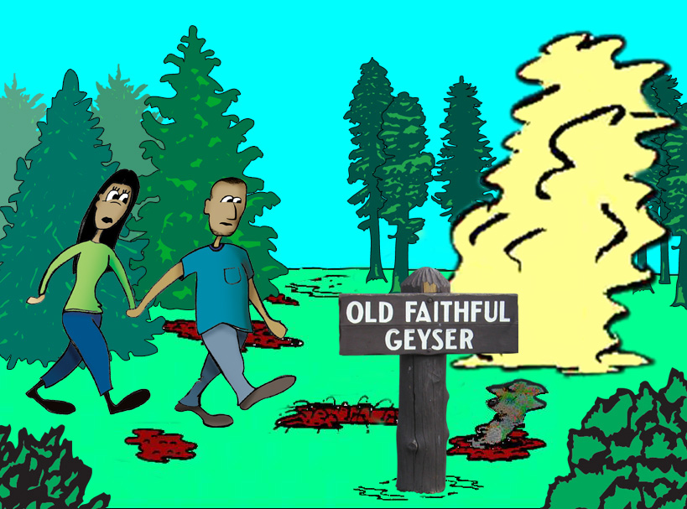
Events: HOW a discussion gets started
Copyright © PREP Educational Products, Inc. 2008. All rights reserved. 303.759.9931.
Notes:
Money is a common problem for a family, regardless of income, age and educational of family members. When family members have different values and attitudes toward spending and saving money or when families strive for unrealistic goals, there is potential for conflict. Suggestions/guidelines:
*When we communicate, what we say may not be as important as HOW we say it.
*Clearly identify the issue at hand—do not drag other points into the discussion that do not address the problem or concern.
*Sometimes the real reason for money disagreements is not related to money at all—management issues (such as power and control)—how we spend to where we spend—When hidden meanings are attached to money and they go unrecognized, trouble brews.
HANDOUT: Communicating about Money and Money Issues

Slide 16
How to communicate about issues like money
Decide when to talk
  Set aside a specific time to talk about issues.
  Use the Speaker Listener Technique.
Decide when not to talk
  Not when you’re riled-up about an event.
  Use Time Outs (if necessary.)
Notes:
Some communication tips:
*Be honest about your money situation
*Know that each family member will have different values and goals
*State your wants, needs, feelings and thoughts
*Use I message—avoid You statements
Refer to Communicating about Money and Money Issues handout

Slide 17
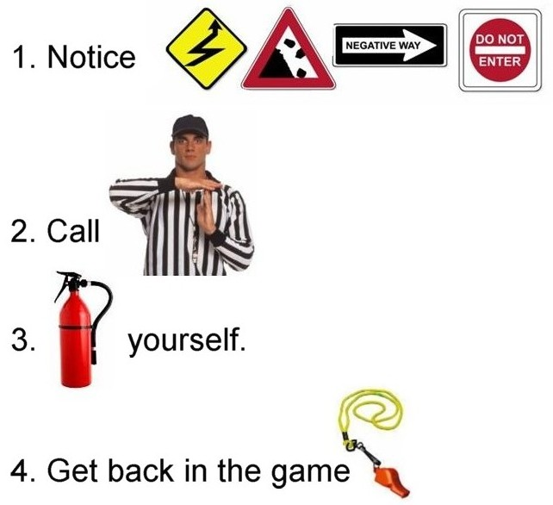
Calling Time Out
Copyright © PREP Educational Products, Inc. 2008. All rights reserved. 303.759.9931.
Notes:
If you notice Escalation, Invalidation, Negative interpretations or Withdrawal/stonewalling call a time out on yourself. Calm yourself. Come back to the issue after a minimum of 30 minutes but within 24 hours.
Glitter bottle optional (glitter with water)

Slide 18

“The Speaker has The Floor.”
Copyright © PREP Educational Products, Inc. 2008. All rights reserved. 303.759.9931.
Notes:
Financial scenarios in small groups

Slide 19
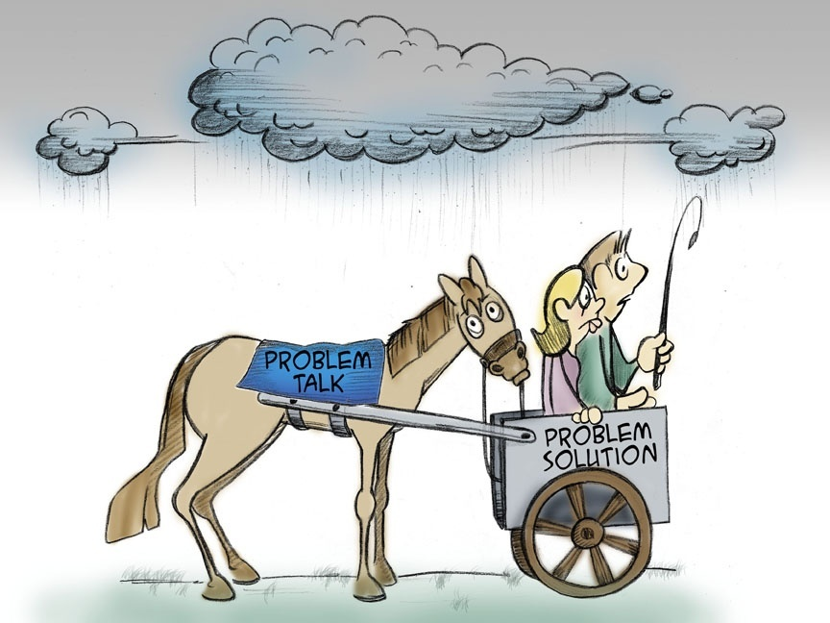
Copyright © PREP Educational Products, Inc. 2008. All rights reserved. 303.759.9931.
Notes:
When we get in a hurry and start trying to solve our problems before we’ve really talked about them thoroughly, it doesn’t turn out very well. It’s like putting the cart before the horse.

Slide 20
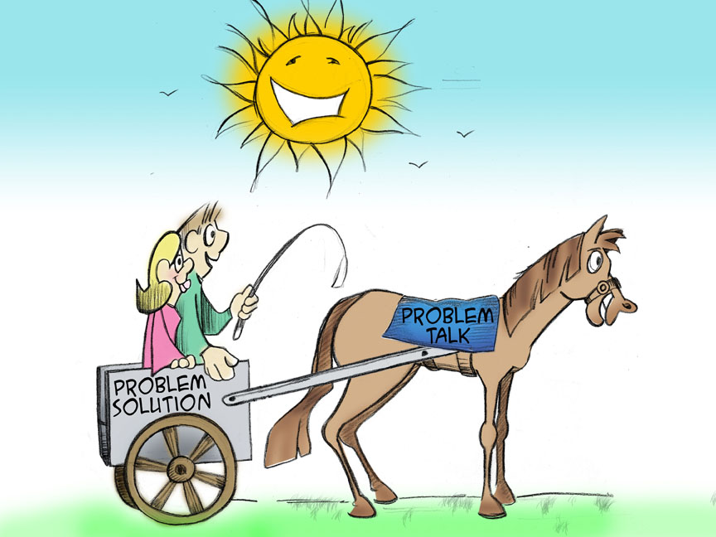
Copyright © PREP Educational Products, Inc. 2008. All rights reserved. 303.759.9931.
Notes:
Problems get solved much more effectively if we put problem talk first and problem solution second.

Slide 21

In Summary
Spin Quest Game
Please complete the evaluation that will launch after this session
Notes:
Review game—wheel

Slide 22
Raising A Money Smart Child
National Endowment for Financial Education www.nefe.com
www.practicalmoneyskills.com
www.themint.org
www.jumpstart.org
www.financial-education-icfe.org
www.kidswealth.com
www.moneyhabitudes.com
Notes:
.

