Slide 1
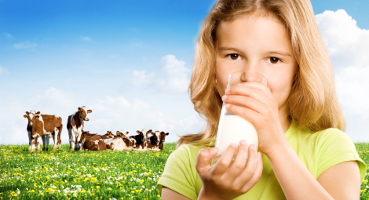
Milk … From Cow to You

Slide 2
From Sun and Grain… COWS EAT GRASS, chopped corn, hay, mixed feed, and water. Then the cow’s body uses these foods to make milk.

Slide 3
To cow…
The cow’s udder is washed. This keeps the milk clean. And it is a signal for the cow to “let down her milk.

Slide 4
Cows are milked by machine at least 2-3 times a day

Slide 5
Pump It…. Cool it…
From the cow, milk is pumped into the bulk tank where is it cooled to keep it fresh and good tasting until the milkman arrives

Slide 6
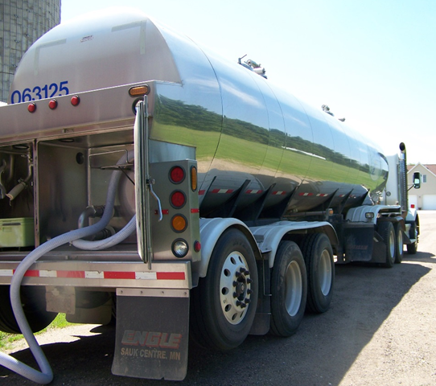
Every day or two, milk is taken to a dairy in an insulated tank truck

Slide 7
Before the milk is pumped into that tanker truck, it is sampled for testing at the lab

Slide 8
To the Dairy Plant…. milk is tested to assure its freshness and safety

Slide 9
Milk is then pasteurized and homogenized.

Slide 10
Pasteurization: milk is heated to 161° F for 15 seconds to kill any bacteria. It is then quickly cooled to maintain quality and freshness

Slide 11
Homogenization…milk is pushed through a screen with tiny holes to break up the fat particles so that they don’t rise to the top

Slide 12
During the entire process milk is NEVER touched by human hands!

Slide 13
Once packaged, milk is stored in a refrigerated room (38-40°) until it is loaded in a delivery truck

Slide 14
TO you!!!!!

Slide 15
Whether it is at home, school or with a friend, it is good for you. That’s because milk helps build strong bones and teeth!

