Slide 1
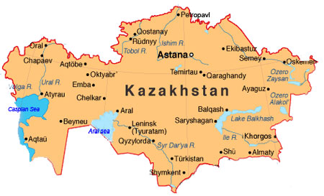
Group XVI’s International Seminar
Kazakhstan March 13-27, 2016
www.leadershipwisconsin.org
MISSION:
Developing Leaders to Strengthen Communities
VISION:
Strong Communities, Effective Leaders, in a Changing World

Slide 2
Group XVI’s International Seminar
Kazakhstan March 13-27, 2016
www.leadershipwisconsin.org
SIGNATURE PROGRAM:
Designed for individuals who have demonstrated themselves as leaders and are ready to take their leadership to the next level.
Participants develop their capacity to lead groups of diverse individuals in the process of finding and implementing inclusive solutions that move their communities, organizations and Wisconsin forward.
The program is constantly evolving to meet the needs of existing and emerging leaders, and focuses on the exploration of issues facing Wisconsin, its people and communities.

Slide 3
Group XVI’s International Seminar
Kazakhstan March 13-27, 2016
www.leadershipwisconsin.org
PURPOSE OF INTERNATIONAL SEMINAR:
Experience alternative or contrasting economic, political, cultural and social systems.
Explore leadership from a different cultural point of view.
Gain new perspectives on significant issues facing other societies.
Examine the difficulties and possibilities of solving societal problems.
Connect with people who are different culturally, socially and economically.
Identify how to apply what is learned in another country to leadership around similar issues in Wisconsin.

Slide 4
Group XVI’s International Seminar
Kazakhstan March 13-27, 2016
www.leadershipwisconsin.org
Kazakhstan focused on the following skills and leadership competencies:
Developing Cultural Intelligence and Intercultural Competencies
Emotional Intelligence (self-awareness and self-management, internal motivation, empathy)
Social Skills (establishing common ground in multiple cultural contexts, managing relationships across lines of difference, building global networks, managing conflict within groups)
Followership
Innovation and Risk Taking
Valuing Diversity and Citizen Diplomacy
Critical Thinking

Slide 5
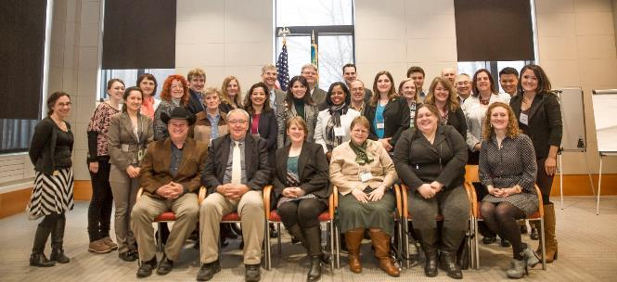
Group XVI’s International Seminar
Kazakhstan March 13-27, 2016
www.leadershipwisconsin.org
DELEGATION:
Tom Charpentier
Kimberly Clist (staff)
Stacy Craig
Grady Gutknecht (alumni)
Becky Hurley
Sarah Kastern
Julie Keown-Bomar (co-chair)
Gary Kirking (co-chair)
Phillip Lotto
Mario Micheli
Shelly Missall
Corinda Rainey-Moore (alumni)
Kalpana Rizal
Eric Roers (alumni)
Ericka Sanchez
Sarah Schlosser (staff)
David Lee Schneider
Tory Tullis
Monica Vick
Theresa Zenchenko

Slide 6
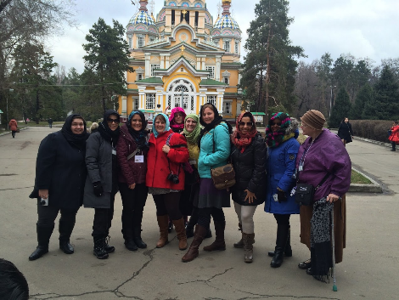
Group XVI’s International Seminar
Kazakhstan March 13-27, 2016
www.leadershipwisconsin.org
Tuesday, March 15, 2016 - Arrive in Almaty
Park of the First President
Zenkov Cathedral (Russian Orthodox)
Panfilov Park & War Memorial
Kazakh Museum of Folk Musical Instruments
Meeting with USAID
Photo by: Becky Hurley

Slide 7
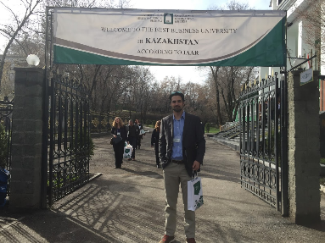
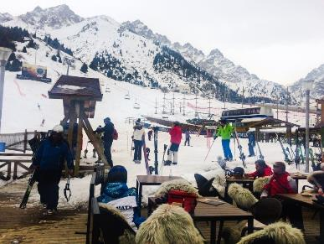
Group XVI’s International Seminar
Kazakhstan March 13-27, 2016
www.leadershipwisconsin.org
Wednesday, March 16, 2016 - Almaty
University of International Business
Kazakh National Agrarian University
Shymbulak Ski Resort
Green Market
Photo by: Phillip Lotto
Photo by: Becky Hurley

Slide 8
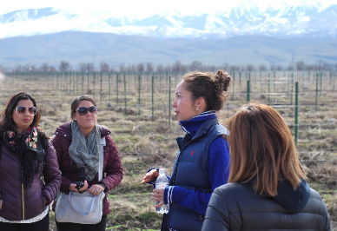
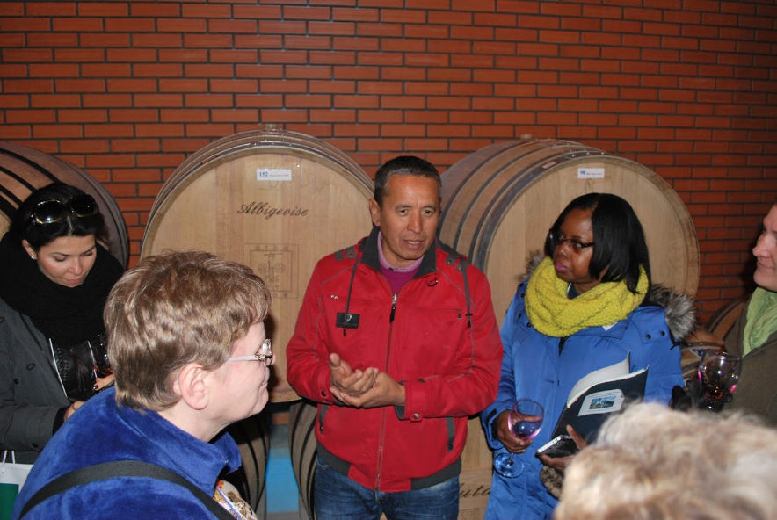
Group XVI’s International Seminar
Kazakhstan March 13-27, 2016
www.leadershipwisconsin.org
Thursday, March 17, 2016 - Almaty & Rural Area
Arba Wine Company
Kazakhstan-Fulfilling the Promise (Vilmur Auken, President, National School of Public Policy for the President of Kazakhstan)
Agriculture Business Center
Cucumber Farmer
Photo by: Phillip Lotto
Photo by: Phillip Lotto

Slide 9
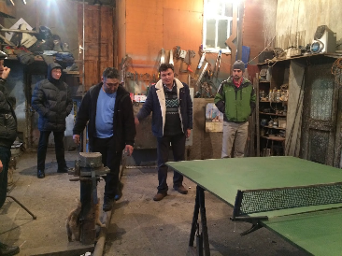
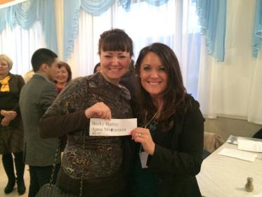
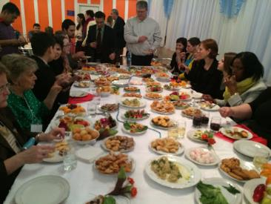
Group XVI’s International Seminar
Kazakhstan March 13-27, 2016
www.leadershipwisconsin.org
Friday, March 18, 2016 - Pavlodar
Official Meeting with Deputy Heads of Pavlodar
Shafer House
Pavlodar Entrepreneurs (Metal Security Doors & Plastic Window Maker)
Meet & Greet with Host Families
Photo by: Becky Hurley
Photo by: Becky Hurley
Photo by: Becky Hurley

Slide 10
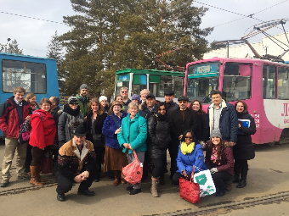
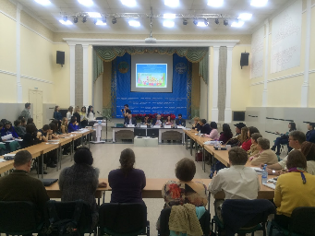
Group XVI’s International Seminar
Kazakhstan March 13-27, 2016
www.leadershipwisconsin.org
Saturday, March 19, 2016 - Pavlodar
Nazarbayev Intellectual School of Pavlodar
Innovative University of Eurasia
Regional Competition Start-up Project Presentations
Pavlodar Entrepreneurs (Metal Coin Maker & Horse Milking Operation)
Tram Tour of Pavlodar
Pavlodar Regional Local
History Museum
Photo(s) by: Becky Hurley

Slide 11
Group XVI’s International Seminar
Kazakhstan March 13-27, 2016
www.leadershipwisconsin.org
Sunday, March 20, 2016 - Pavlodar
Election Day
Spent entire day with Pavlodar host family

Slide 12
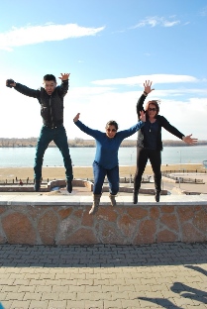
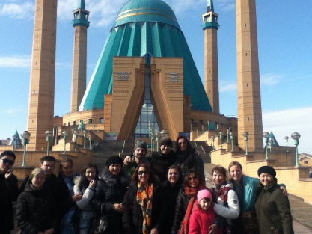
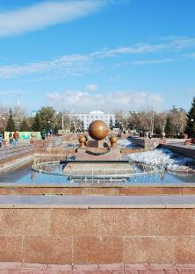
Group XVI’s International Seminar
Kazakhstan March 13-27, 2016
www.leadershipwisconsin.org
Monday, March 21, 2016 - Pavlodar
Green Mosque and Catholic Church
Sarishiganak Village and American Corner Presentation
Photo by: Phillip Lotto
Photo by: Stacy Craig
Photo by: Phillip Lotto

Slide 13
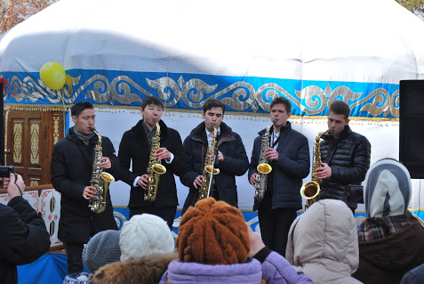
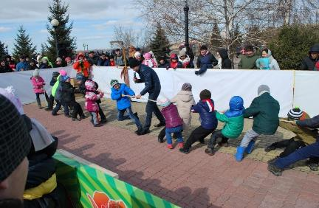
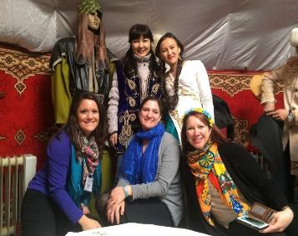
Group XVI’s International Seminar
Kazakhstan March 13-27, 2016
www.leadershipwisconsin.org
Tuesday, March 22, 2016 - Pavlodar
Nauryz Holiday & Festival
Innovative University of Eurasia Yurt
English Club
Dinner Celebration with Host Families
Photo(s) by: Phillip Lotto
Photo by: Becky Hurley

Slide 14
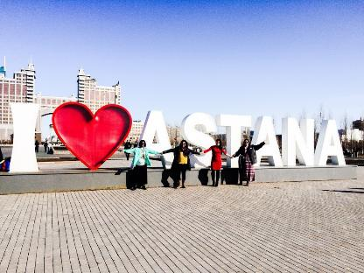
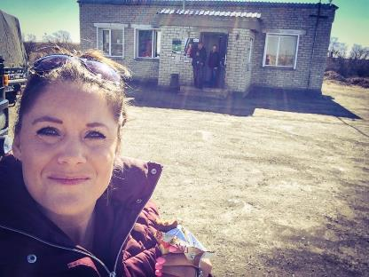
Group XVI’s International Seminar
Kazakhstan March 13-27, 2016
www.leadershipwisconsin.org
Wednesday, March 23, 2016 - Travel to Astana
Epic Bus Ride
Stop @ best dumpling restaurant ever!
Photo by: Becky Hurley
Photo by: Becky Hurley

Slide 15
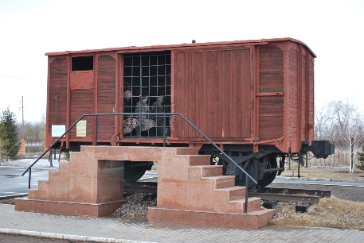
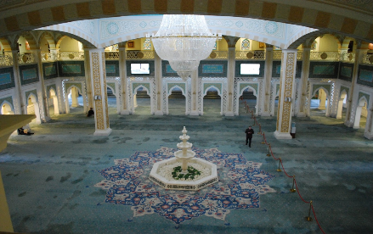
Group XVI’s International Seminar
Kazakhstan March 13-27, 2016
www.leadershipwisconsin.org
Thursday, March 24, 2016 - Astana
Hazrat Sultan Mosque
National Museum
Alzhir Women’s Prison Camp
Photo(s) by: Phillip Lotto

Slide 16
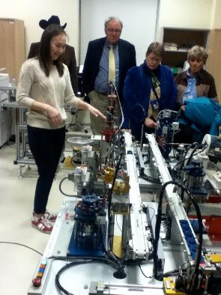
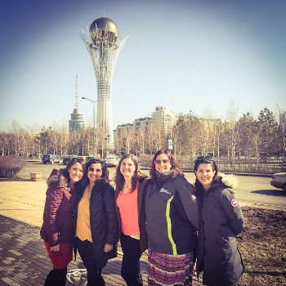
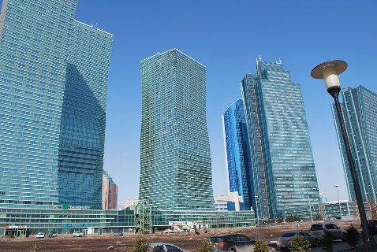
Group XVI’s International Seminar
Kazakhstan March 13-27, 2016
www.leadershipwisconsin.org
Friday, March 25, 2016 - Astana
U.S. Embassy in Kazakhstan
Nazarbayev University
Photo by: Stacy Craig
Photo by: Phillip Lotto
Photo by: Becky Hurley

Slide 17
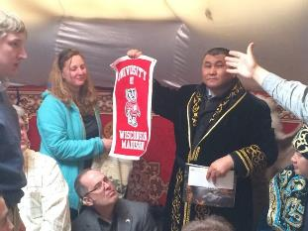
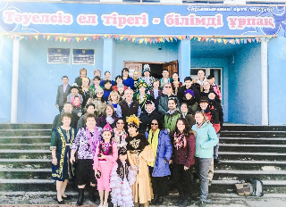
Group XVI’s International Seminar
Kazakhstan March 13-27, 2016
www.leadershipwisconsin.org
Saturday, March 26, 2016 - Astana
Seminar Debriefing Discussion in hotel
Leadership as Observed During the Trip
Final Exploration of Seminar Themes
“What Next” As You Prepare to Return Home
Lunch with Open World Delegates
Optional Activities
Photo(s) by: Becky Hurley

