Slide 1
Connecting The Dots
The Importance of
Collaboration
May 24, 2016
Nancy Schultz
Family Living Educator

Slide 2
Ice Breaker Exercise
Find a partner you don’t know well. Ask,
What do you do?
Why is it important to you?
Hmmm, why is that important to you?
Keep asking, “Why is that important to you? why…” until you make a discovery about the fundamental purpose behind why your partner’s work is important.

Slide 3
Quote from Henry Ford
"Coming together is a beginning,
keeping together is progress, and working together is success."
- Henry Ford-
Source: www.engagingalllearners.ca/.../collaborative.../collaboration_champion_1_day_works...

Slide 4
People Talk Collaboration
They emphasize the importance of it
Yet when it comes to walking the talk
Do we really embrace it?
What does Collaboration TRULY mean?
Why collaborate?
What are the principles of effective collaboration?
How do we DO collaboration – is it a matter of will or skill?
Source: www.engagingalllearners.ca/.../collaborative.../collaboration_champion_1_day_works...

Slide 5
Welcoming Expectations
Everyone has wisdom
We need everyone’s wisdom for the wisest result
There are no wrong answers
The whole is greater than the sum of it’s parts
Everyone will hear others and be heard
You can always change your mind
Source: www.engagingalllearners.ca/.../collaborative.../collaboration_champion_1_day_works...

Slide 6
What is Collaboration
Collaboration occurs when a number of community organizations, agencies, and individuals make a commitment to work together and contribute resources to obtain a common, long-term goal.
Source: http://ojp.gov/fbnp/pdfs/Collaboration_Toolkit.pdf

Slide 7
Connecting the Dots

Slide 8
From Isolation Impact to Collective Impact
Isolated Impact
Funders select individual grantees
Organizations work separately
Evaluation attempts to isolate a particular organization’s impact
Large scale change is assumed to depend on scaling organizations
Corporate and government sectors are often disconnected from foundations and non-profits.
Collective Impact
Funders understand that social problems – and their solutions – arise from multiple interacting factors.
Cross-sector alignment with government, nonprofit, and corporate sectors as partners.
Organizations actively coordinating their actions and sharing lessons learned.
All working toward the same goal and measuring the same things.
Source: Collective Impact and Community Change.
Liz Weaver, Tamarack – An Institute for Community Engagement

Slide 9
Why Collaborate?
Pooling of financial & human resources
Sharing of expertise/perspective
To answer questions
Collaboration
Gain greater creditability
Shared responsibility
Increase efficiency & funding opportunities
Share skills in navigating through systems
Source: http://collaborations-in-libraries.wikispaces.com/Why+Collaborate%3F

Slide 10
Personal Stories
Activity
Think about a specific example where you and/or your school/agency/organization have demonstrated collaborative practices in action.
“A shift from me to we”
Source: www.engagingalllearners.ca/.../collaborative.../collaboration_champion_1_day_works...

Slide 11
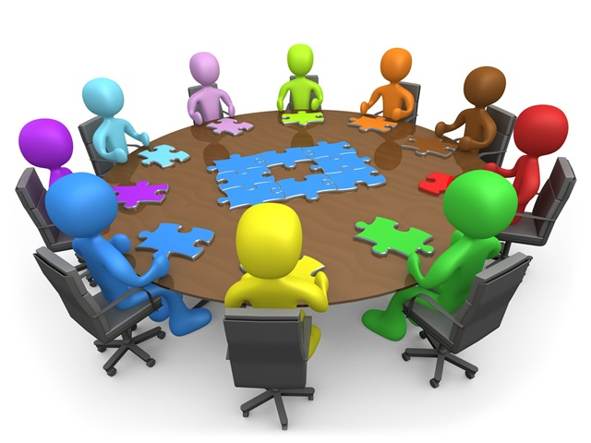
Who Makes it Happen?

Slide 12
What is Collective Impact ?
Source: https://www.youtube.com/watch?v=pzmMk63ihNM

Slide 13
The Five Conditions of Collective Impact
All participants have a shared vision for change including a common understanding of the problem and a joint approach to solving it through agreed upon actions
Common Agenda
Shared Measurement
Collecting data and measuring results consistently across all participants ensures efforts remain aligned and participants hold each other accountable
Mutually Reinforcing Activities
Participant activities must be differentiated while still being coordinated through a mutually reinforcing plan of action
Continuous Communication
Consistent and open communication is needed across the many players to build trust, assure mutual objectives, and appreciate common motivation
Creating and managing collective impact requires a dedicated staff and a specific set of skills to serve as the backbone for the entire initiative and coordinate participating organizations and agencies
Backbone Support
Source: Collective Impact and Community Change.
Liz Weaver, Tamarack – An Institute for Community Engagement
10

Slide 14
Common Agenda
Define the challenge to be addressed
Acknowledge that a collective impact approach is required.
Establish clear and shared goals for change
Identify principles to guide joint work together.
Source: Collective Impact and Community Change.
Liz Weaver, Tamarack – An Institute for Community Engagement

Slide 15
Sharing Measurements
Identify key measures that capture critical outcomes.
Establish systems for gathering and analyzing measures.
Create opportunities for “making sense” of changes in indicators.
Source: Collective Impact and Community Change.
Liz Weaver, Tamarack – An Institute for Community Engagement

Slide 16
Mutually Reinforcing Activities
+
+
+
Agree on key outcomes
Orchestrate and specialize
Complementary – sometimes “join up” strategies to achieve outcomes.
Source: Collective Impact and Community Change.
Liz Weaver, Tamarack – An Institute for Community Engagement

Slide 17
Continuous Communication
Create formal and informal measures for keeping people informed.
Communication is open and reflect a diversity of style.
Difficult issues are surfaced, discussed and addressed.
Source: Collective Impact and Community Change.
Liz Weaver, Tamarack – An Institute for Community Engagement

Slide 18
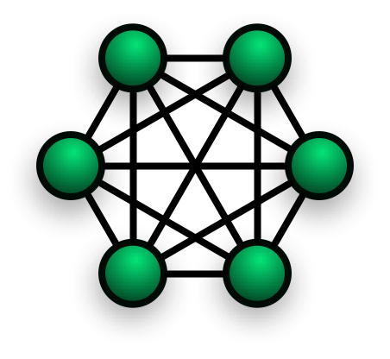
Backbone Infrastructure
Guide the vision and strategy
Support aligned activities
Establish shared measurements
Build public will
Advance policy
Mobilize funding
Source: Collective Impact and Community Change.
Liz Weaver, Tamarack – An Institute for Community Engagement

Slide 19
Final Reflections
Everyone has a piece in this

Slide 20
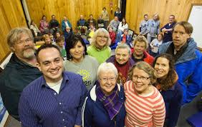
Example of Collaboration

Slide 21
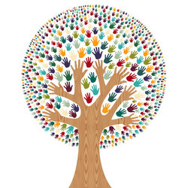
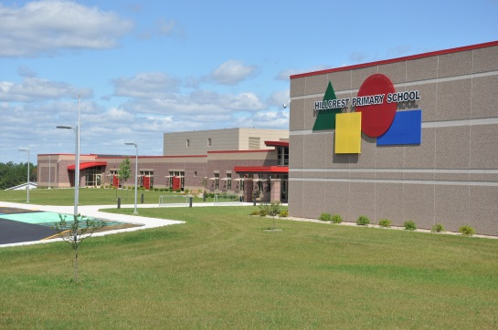
Another Example
Shawano Family Resource Center located at Hillcrest Primary School

Slide 22
Quote from Helen Keller
Alone we can do so little
…together we can do so much
Helen Keller
Source: www.engagingalllearners.ca/.../collaborative.../collaboration_champion_1_day_works...

