Slide 1





The Foundation of Workforce Development
Jay Moynihan, UW-Extension Community Resource Development
(715) 526 – 6136 jay.moynihan@ces.uwex.edu

Slide 2





The Federal Reserve System
My presentation is comprised in part of materials from:
Shawano

Slide 3

This presentation contains
narrative sound files
If you do not hear my voice on a slide where this symbol appears, click on the symbol on the slide to hear it

Slide 4
Foundation:
The basis or groundwork of anything
The natural or prepared ground or base on which some structure rests
The act of founding, setting up, establishing, etc.

Slide 5
Old Model
Fate
Free Will
Parents
Genes
Environment
Successful
Black Box
Unsuccessful
WRONG!

Slide 6
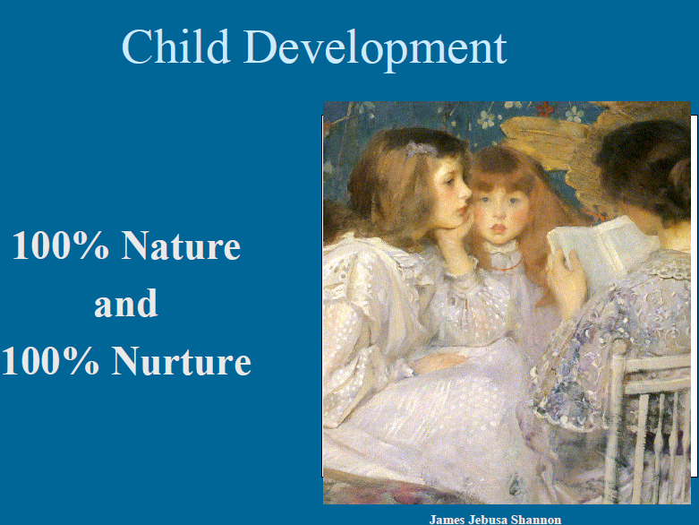

Slide 7
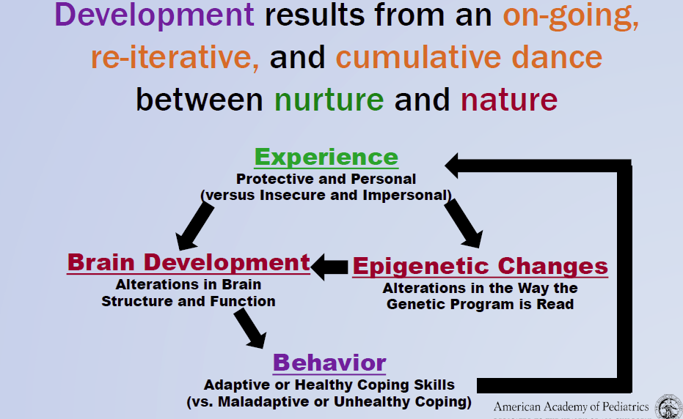
Evidenced Based Model

Slide 8
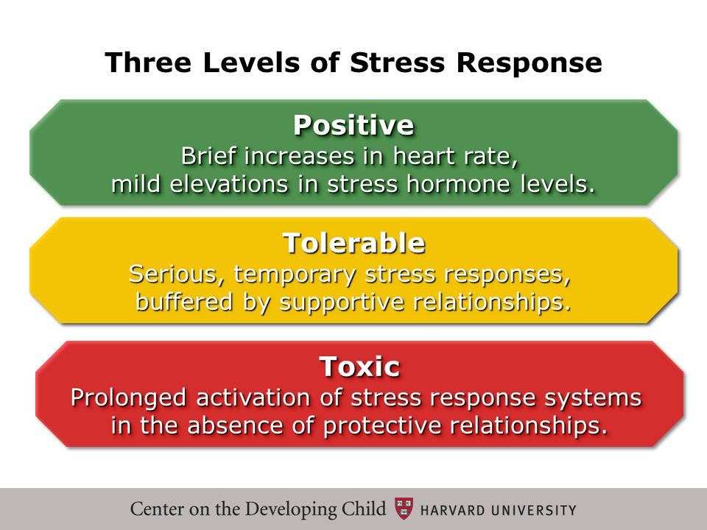

Slide 9
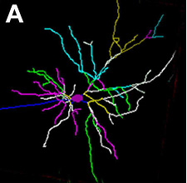
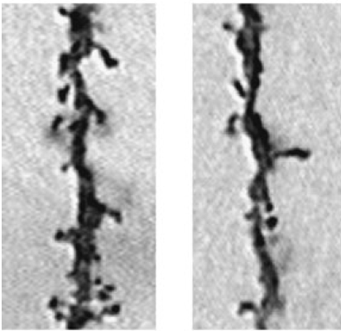
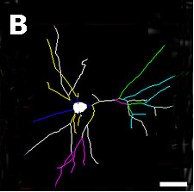
Toxic Stress Changes Brain Architecture
Normal
Typical neuron— many connections
Toxic
stress
Damaged neuron— fewer connections
Prefrontal Cortex
and Hippocampus
Sources: Neuron depiction – Morrison & McEwen (2008); Photo – Bock et al. (2005)
9

Slide 10
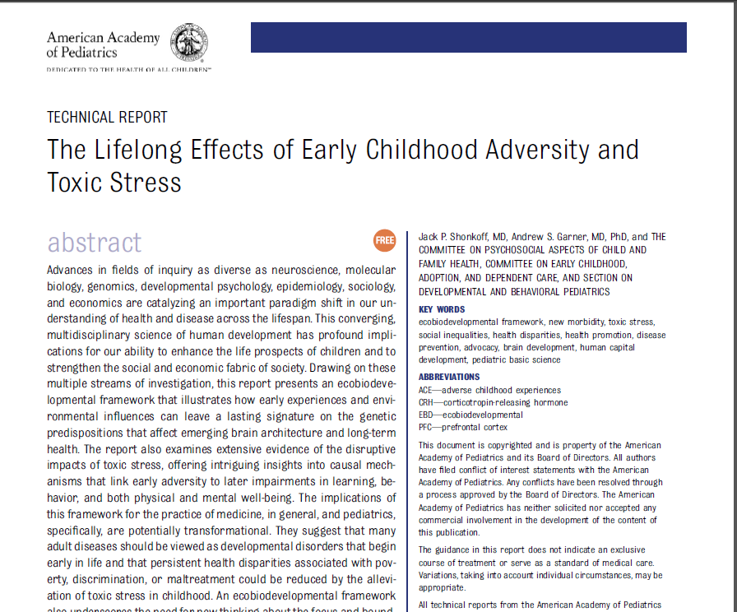

“A vital and productive society with a
prosperous and sustainable future is
built on a foundation of healthy child
development.
Health in the earliest years—beginning with the future mother’s well-being before she becomes pregnant — lays the groundwork for a lifetime of the physical and mental vitality that is necessary for a strong workforce
and responsible participation in community life.”
http://pediatrics.aappublications.org/content/early/2011/12/21/peds.2011-2663.full.pdf
Notes:
“The basic science of pediatrics. An emerging,
multidisciplinary science of development supports
an EBD framework for understanding the
evolution of human health and disease across
the life span. In recent decades, epidemiology,
developmental psychology, and longitudinal
studies of early childhood interventions have
demonstrated significant associations (hashed
red arrow) between the ecology of childhood
and a wide range of developmental outcomes
and life course trajectories. Concurrently, advances
in the biological sciences, particularly in
developmental neuroscience and epigenetics,
have made parallel progress in beginning to
elucidate the biological mechanisms (solid
arrows) underlying these important associations.
The convergence of these diverse disciplines
defines a promising new basic science
of pediatrics.”

Slide 11
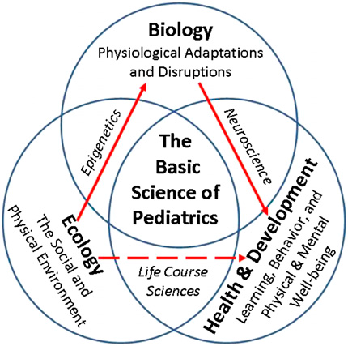
http://pediatrics.aappublications.org/content/early/2011/12/21/peds.2011-2663.full.pdf
Notes:
“The basic science of pediatrics. An emerging,
multidisciplinary science of development supports
an EBD framework for understanding the
evolution of human health and disease across
the life span. In recent decades, epidemiology,
developmental psychology, and longitudinal
studies of early childhood interventions have
demonstrated significant associations (hashed
red arrow) between the ecology of childhood
and a wide range of developmental outcomes
and life course trajectories. Concurrently, advances
in the biological sciences, particularly in
developmental neuroscience and epigenetics,
have made parallel progress in beginning to
elucidate the biological mechanisms (solid
arrows) underlying these important associations.
The convergence of these diverse disciplines
defines a promising new basic science
of pediatrics.”

Slide 12

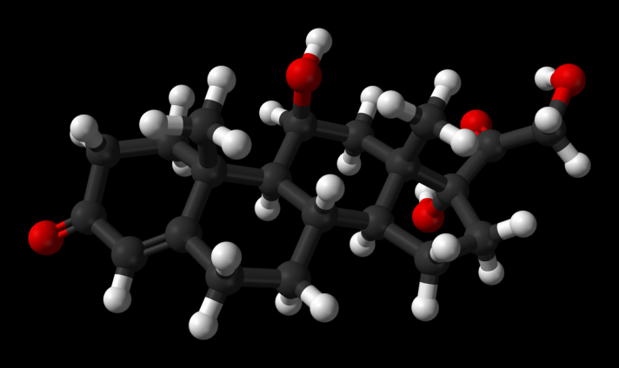
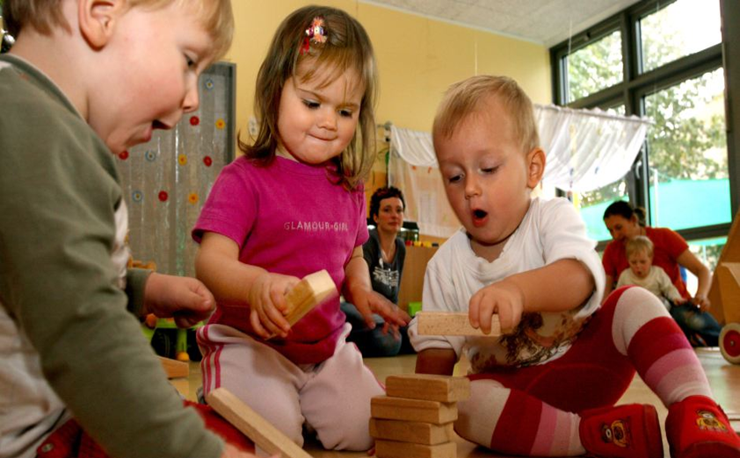
The big picture Take Away 1
VS
Cortisol
(Stress)

Slide 13
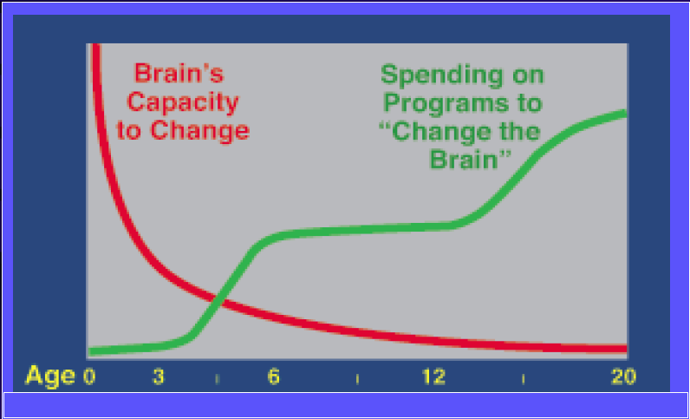
The big picture Take Away 2

Slide 14

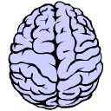

Slide 15
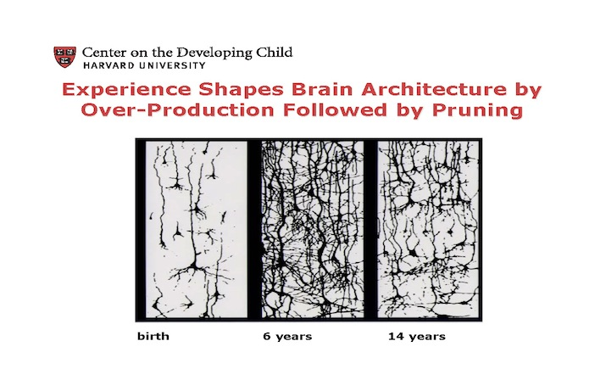
Interaction Turns Genes On

Slide 16
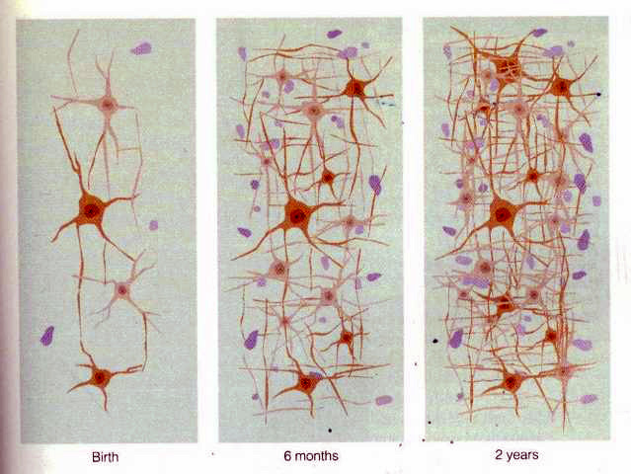
Experience Drives Brain Development

Slide 17
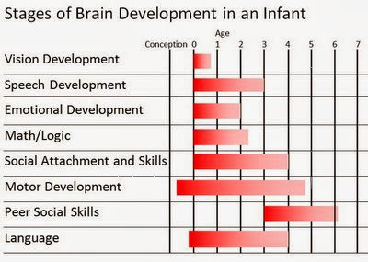

Slide 18
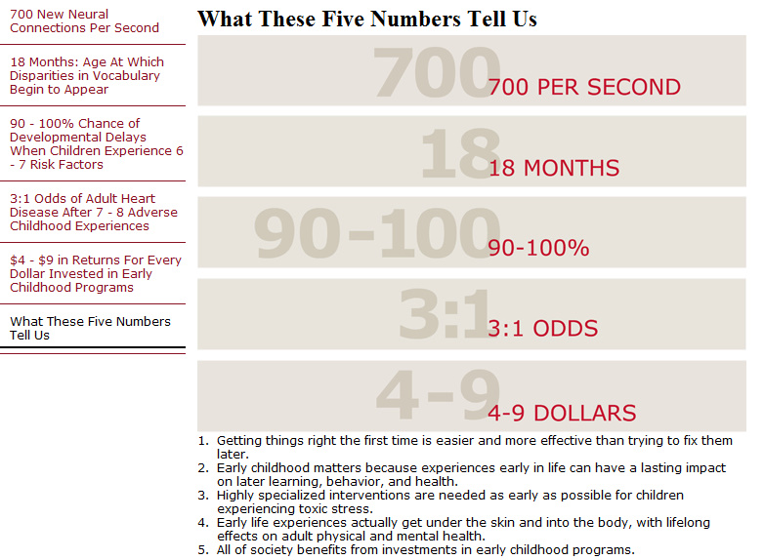

Slide 19



Three Types of Executive Function Skills
Inhibitory Control — Filter
thoughts and impulses to resist
temptations and distractions
Working Memory — Hold and manipulate information in our heads over short periods
of time
Mental Flexibility — Adjust to changed
demands, priorities or perspectives
19

Slide 20

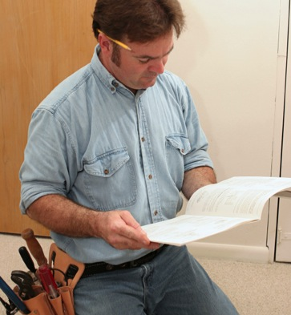

What Do These Skills Look Like in Adults?
Inhibitory Control — Filter
thoughts and impulses to resist
temptations and distractions
Working Memory — Hold and manipulate information in our heads over short periods
of time
Mental Flexibility — Adjust to changed
demands, priorities or perspectives
20

Slide 21

An “Air Traffic Control System” in the Brain
Executive functioning is a group of skills that help us to focus on multiple streams of information at the same time, set goals and make plans, make decisions in light of available information, revise plans and resist hasty actions.
A key biological foundation of school readiness as well as outcomes in health and employability
21

Slide 22

Brain Architecture Supports
Lifelong Learning, Behavior and Health
Brains are built over time,
starting in the earliest years
of life. Simple skills come
first; more complex skills
build on top of them.
Cognitive, emotional, and
social capabilities are
inextricably intertwined throughout the life course.
A strong foundation in the early years improves the odds for positive outcomes, and a weak foundation increases the odds of later difficulties.
22

Slide 23
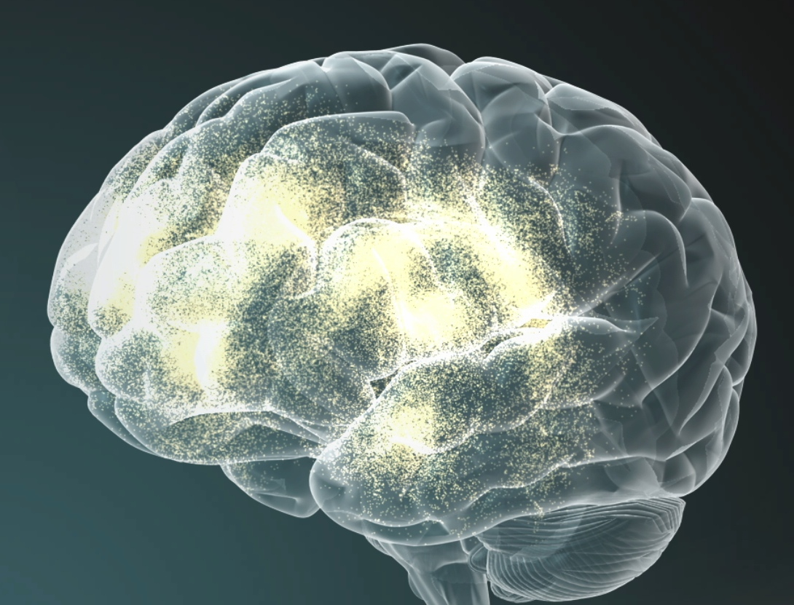
Executive Function and Self-Regulation Require Multiple Brain Regions To Be Connected
Prefrontal Cortex:
Regulates thoughts, emotions, actions
Hippocampus:
Short-term memory helps us make sense of emotions
Error
Processing
Behavioral Control
Reaction and Responses
Use of Rules
Working Memory
Risk/Reward Decisions
Emotions
Amygdala:
Triggers emotional responses
23

Slide 24
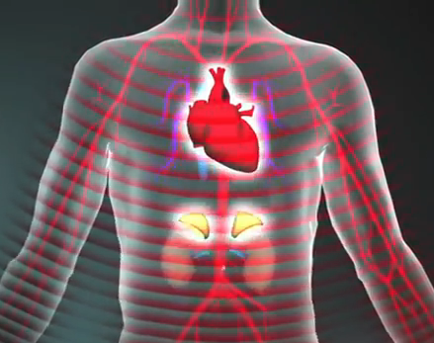
Relationships Buffer the Effects of Stress
Learning how to cope with
moderate, short-lived stress
can build a healthy stress
response system.
Toxic stress—when the body’s
stress response system is
activated excessively—can
weaken developing brain
architecture.
Without caring adults to buffer children, toxic stress associated with extreme poverty, neglect, abuse or severe maternal depression can have long-term consequences for learning, behavior, and both physical and mental health.
24

Slide 25
The Development of Executive Function Skills Begins in Early Childhood and Extends into the Early Adult Years
Skill Proficiency
Birth
3
5
10
15
25
30
50
70
80
Age (Years)
Source: Weintraub et al. (2011)
25

Slide 26

The Bottom Line

Slide 27

Rob Grunewald
Economist
Federal Reserve Bank of Minneapolis
The Economic Case for Investments in Young Children
27

Slide 28
What Do These Skills Look Like in Adults?
Inhibitory Control — Filter
thoughts and impulses to resist
temptations and distractions
Working Memory — Hold and manipulate information in our heads over short periods
of time
Mental Flexibility — Adjust to changed
demands, priorities or perspectives
28

Slide 29
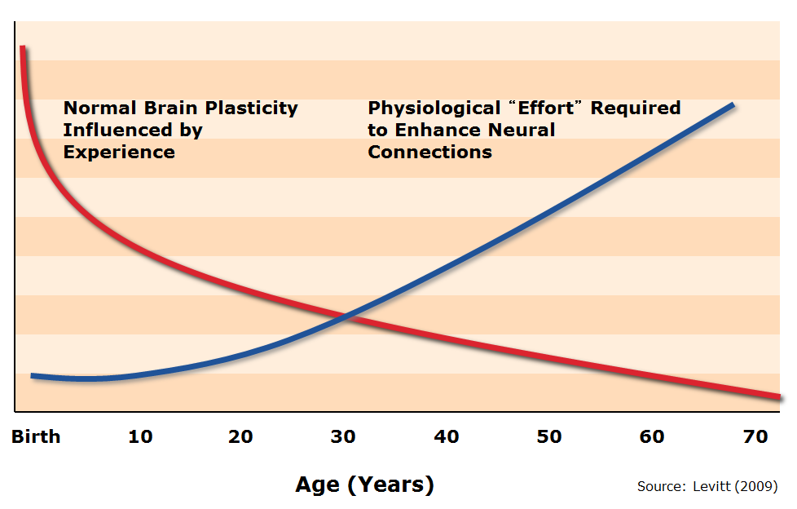
The Ability To Change Brains
Decreases Over Time
Age (Years)
Source: Levitt (2009)
29

Slide 31
High/Scope Study of Perry Preschool
In early 1960s, 123 children from low-income families in Ypsilanti, Mich.
Children randomly selected to attend Perry or control group
High-quality program with well-trained teachers, daily classroom sessions and weekly home visits
Tracked participants and control group through age 40
31

Slide 32
Perry: Educational Effects
Source: Schweinhart et al. (2005)
32

Slide 33
Perry: Economic Effects at Age 40
Source: Schweinhart et al. (2005)
33

Slide 34
Perry Preschool:
Costs and Benefits Over 62 Years
Source: Schweinhart et al. (2005)
34

Slide 35
Perry Preschool:
Estimated Return on Investment
Benefit-Cost Ratio = $16 to $1
Annual Rate of Return = 18%
Public Rate of Return = 16%
Heckman Reanalysis = 10%
Sources: Schweinhart et al. (2005); Author’s calculations; Heckman et al. (2010)
35

Slide 36
Short-Run Benefits
Fewer low-weight and preterm births
Fewer emergency room visits
Reduced child abuse and neglect
Reduced grade retention and special education
Reduced employee absenteeism and turnover
36

Slide 37
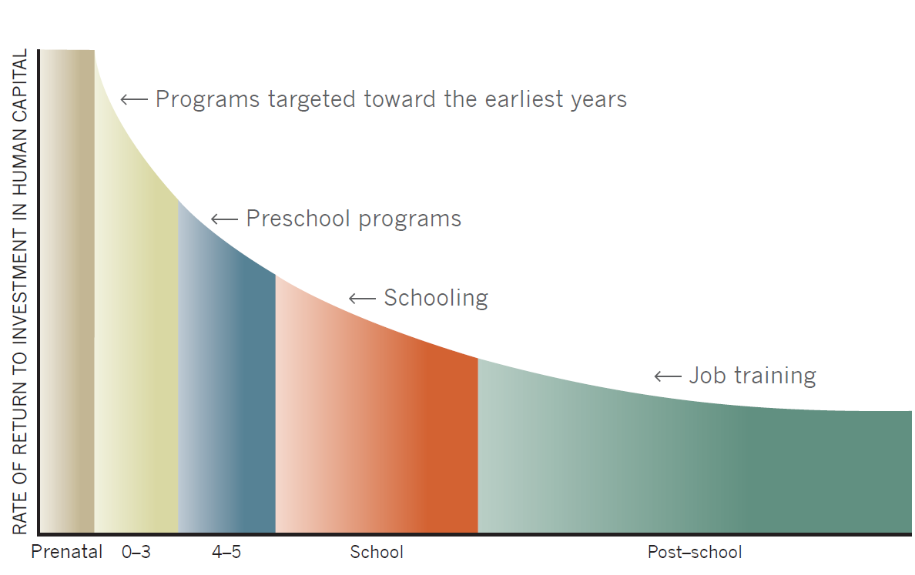
Returns to a Unit Dollar Invested
Source: Heckman, J.J. (2008). “Schools, Skills and Synapses,” Economic Inquiry 46(3):289-324
37

Slide 38
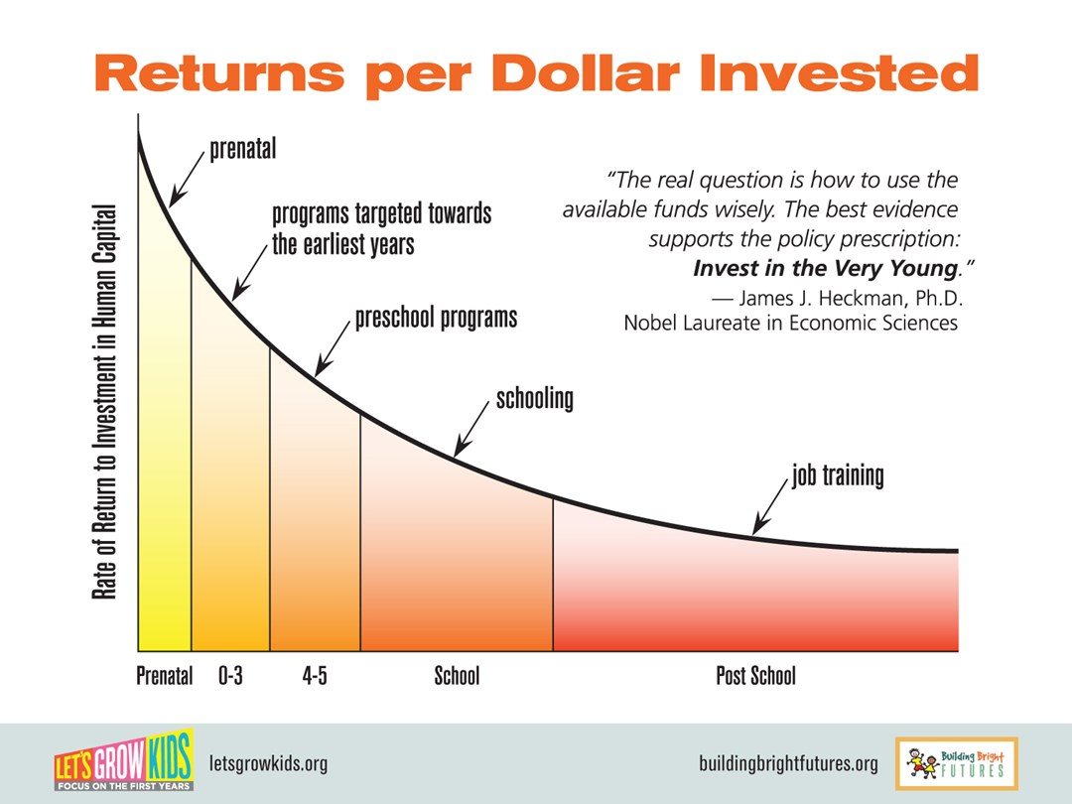

Slide 39
Key Investments
Home visiting
Preschool
Quality child care
Parent education
Health care
39

Slide 40

Things We Can Do

Slide 41
Three Types of Executive Function Skills
Inhibitory Control — Filter
thoughts and impulses to resist
temptations and distractions
Working Memory — Hold and manipulate information in our heads over short periods
of time
Mental Flexibility — Adjust to changed
demands, priorities or perspectives
41

Slide 42







These Same Skills Are Needed by the
Adults Who Care for Children
Violence
Responsive Caregiving
Mental Illness
Chaos
Stress
Stable Environments
Substance Abuse
Poverty
Economic
Self-Sufficiency
Maltreatment
42

Slide 44


Notes:
From fed reserve materials

Slide 45
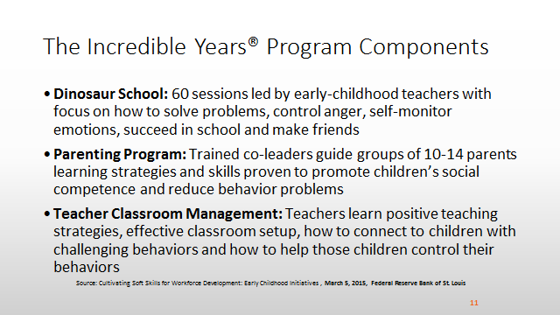
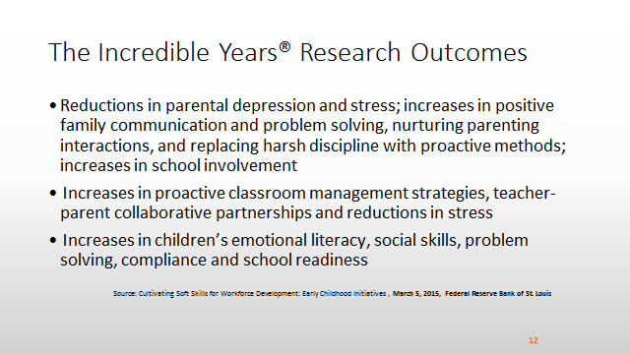
Notes:
From fed reserve materials

Slide 46
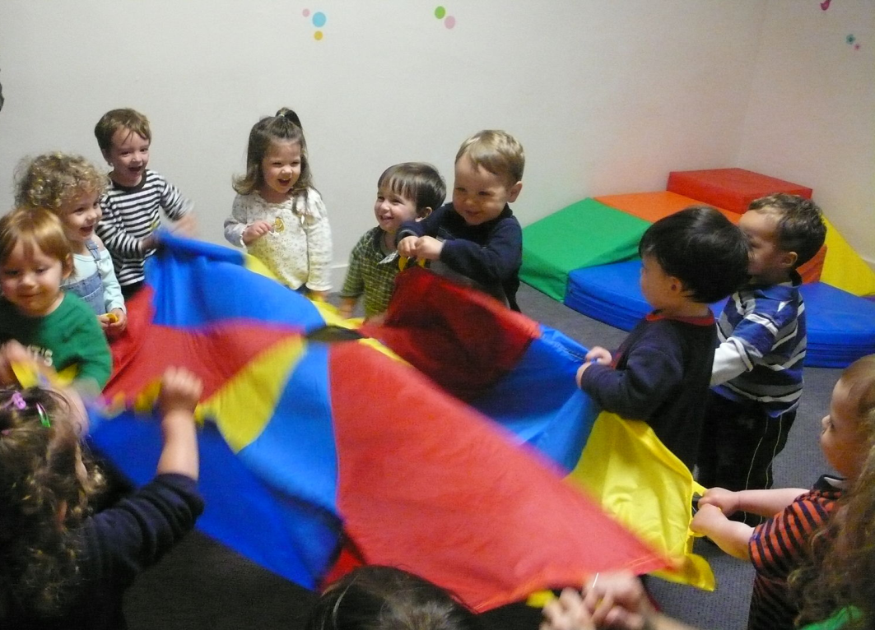
Your future employees in training?
Do your employees have affordable quality daycare?
Do your employees have daycare where they work?
Do you and other employers support area daycare providers?
Notes:
Again, 80% of impact on soft skills and executive skills is during 0-5 years

Slide 47



Is your:
business, school, club, church or organization hosting these?
Notes:
Collage from Foundations of Workforce Development workshop

Slide 48

Success By Six
Importance of Early learning
  Cradle to School
  Brain Development
  Needs Fulfillment
Parental Involvement
Focused Programs
Community Involvement
Born Learning
Program Discussion
Identify opportunities for collaboration
Prune redundancy
Think/act as a Team focused on Early Learning

Slide 49

Born Learning
“The Born Learning Academy program was originally developed in Kentucky by the United Way of Kentucky and Toyota Motor Manufacturing, Kentucky, Inc. in 2009. The concept is based on the Harlem Children’s Zone Baby College and emphasizes the importance of early learning. The West Virginia-based academies are part of program expansion to states with Toyota manufacturing plants.“ We are committed to helping develop the workforce for the future, not just for Toyota but for all business and industry,”…

Slide 50
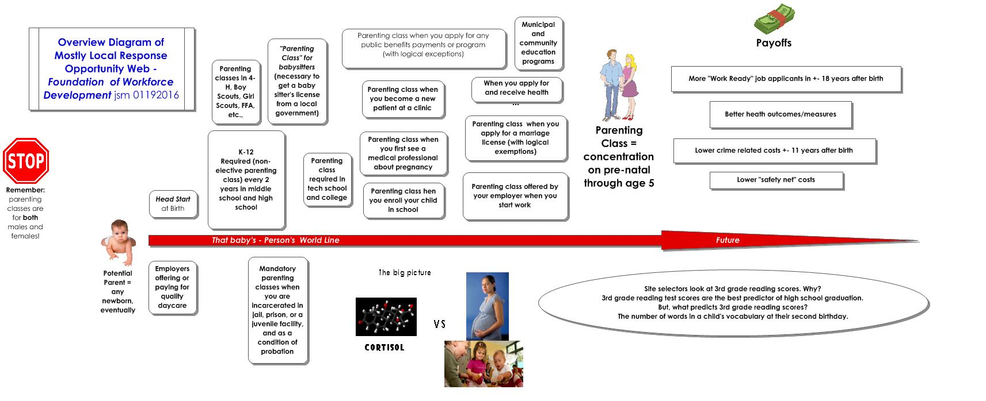

Slide 51
“If there is one thing developmental psychologists have learned over the years, it is that parents don’t have to be brilliant psychologists to succeed. They don’t have to be supremely gifted teachers. Most of the stuff parents do with flashcards and special drills and tutorials to hone their kids into perfect achievement machines don’t have any effect at all. Instead, parents just have to be good enough. They have to provide their kids with stable and predictable rhythms. They need to be able to fall in tune with their kids’ needs, combining warmth and discipline. They need to establish the secure emotional bonds that kids can fall back upon in the face of stress. They need to be there to provide living examples of how to cope with the problems of the world so that their children can develop unconscious models in their heads.”
David Brooks, The Social Animal: The Hidden Sources of Love, Character, and Achievement

Slide 52
Discussion:
What is your role?
What can we work on together?

Slide 53
Next are a few slides of resource links …

Slide 54


Excellent for a business or government audience:
Federal Reserve Banks of St. Louis & Minneapolis, Cultivating Soft Skills in Workforce Development: Early Childhood Initiatives, ( 03/2015)
https://bsr.stlouisfed.org/EI_CDAudioConference/#23/cultivating-soft-skills-in-workforce-development-early-childhood-initiatives
The Raising of America
documentary series
http://www.raisingofamerica.org /
Our public health department and our office use this video series.

Slide 55


PowerPoint presentations about:
https://www.aap.org/en-us/advocacy-and-policy/aap-health-initiatives/EBCD/Pages/Powerpoint-Presentations.aspx

Slide 56

AAP Pediatrics for the 21st Century symposium videos
Promoting Early Brain and Child Development (EBCD):
Building Brains, Forging Futures
https://pedialink.aap.org/visitor/cme/about_aap_cme/PEDS-21-2013-Agenda-and-Learning-Objectives?pageId=18c39bb1-3268-4c87-9652-396d22e4c473,6ee2af48-f895-4c00-acd3-b63e3805066d,6ee2af48-f895-4c00-acd3-b63e3805066d,6ee2af48-f895-4c00-acd3-b63e3805066d

Slide 57

The economic development case
for preschool education
http://www.ted.com/talks/timothy_bartik_the_economic_case_for_preschool

